Slide 1
Excel with Data
Adam Little
3/10/2018
[website]

Slide 2
PivotTable
Bill Jelen (a.k.a. Mr. Excel)
No other tool in Excel gives you the flexibility and analytical power of a pivot table.
Powerful
Fun

Slide 3
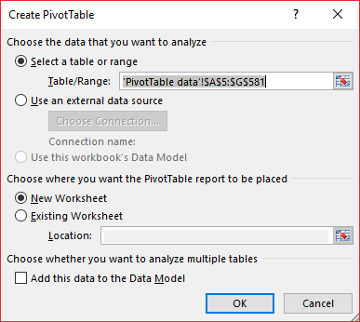
PivotTable (cont.)
Important rules
Data organized into columns with headings
No empty columns or rows
Can have empty cells
Consistent data (dates in date column, numbers in number column)
“PivotTable data” worksheet
Insert → PivotTable

Slide 5
PivotTable (cont.)
Designing Your Pivot Table
Select PivotTable Field
Drag the selected fields into appropriate area
Filters
Columns
Rows
Values

Slide 6
PivotTable (cont.)
Rows: School Year, LEA
Column: Item
Values: Quantity
Notes:
If rows are not expanding automatically, in PivotTable Tools -> Analyze -> Active Field -> Expand All (Collapse All)

Slide 7
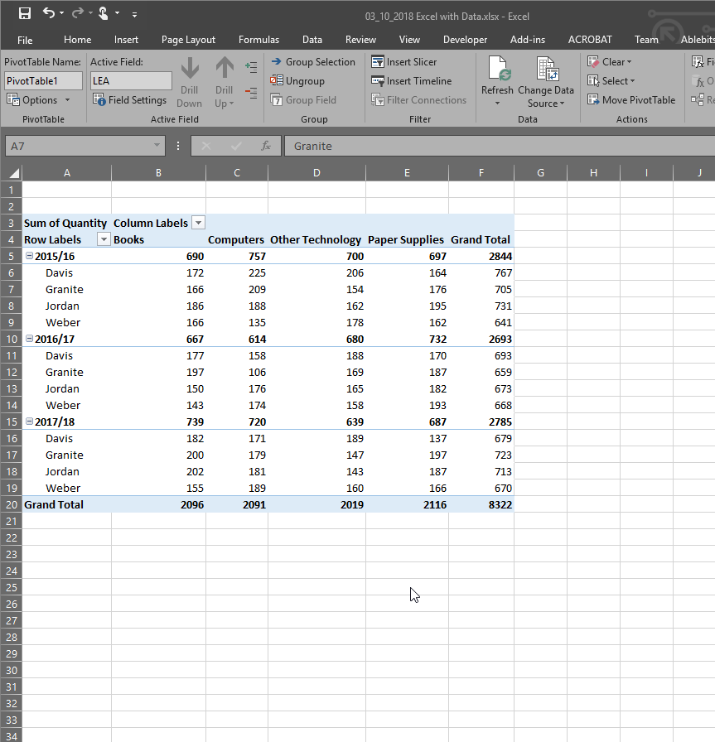

Slide 8
PivotTable (cont.)
Updating PivotTable
Delete line 582-593
On Sheet 2
Analyze → Data → Change Data Source
Analyze → Data → Refresh

Slide 9
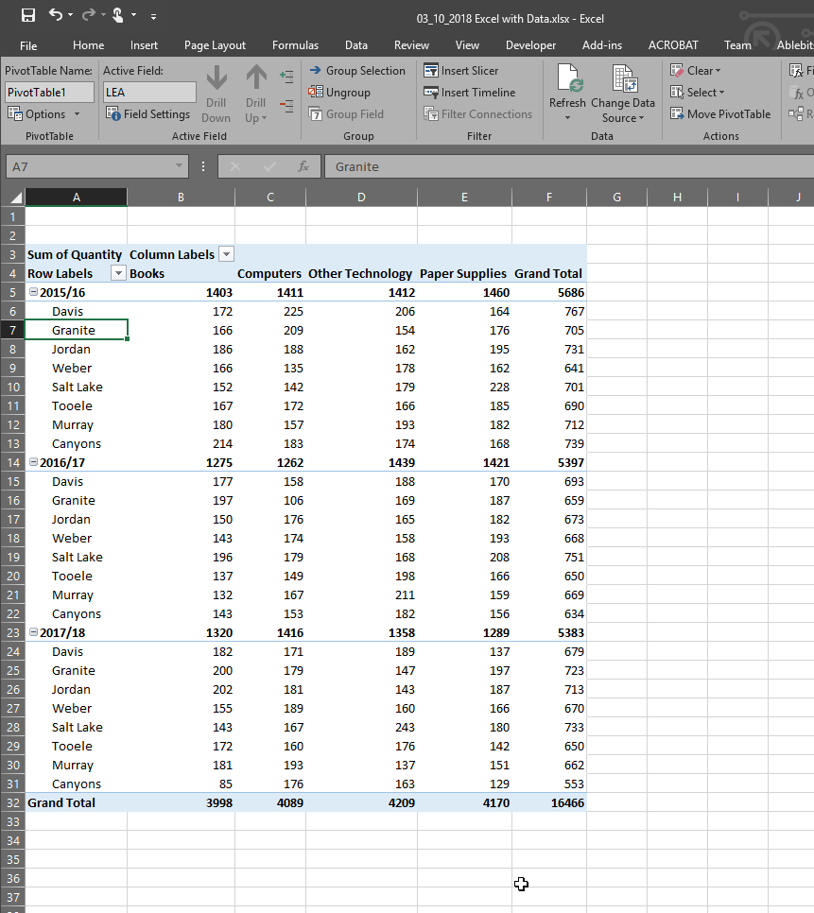

Slide 10
PivotTable (cont.)
Grouping
Excel 2016 – automatic time grouping
Move date into rows
Analyze -> Group -> Group Field -> Select “Months” & “Years”
Clearing PivotTable
Analyze -> Actions -> Clear -> “Clear All”

Slide 11
PivotTable (cont.)
Which LEA spent the most amount of money?
Which LEA bought the least amount of computers?
Which item cost the most amount of money?
Which month in school year 2016/17 had the largest total cost?
Which month had the largest total cost?
Davis - $857,970
Tooele – 481
Books - $1,399,300
Sept 2016 - $192,700
July: $610,870
Notes:
Analyze -> Actions -> Clear -> Clear All

Slide 12
Protect
Encrypt an Excel file with a password so that it requires a password to open it
The workbook structure, users cannot insert, delete, rename, move, copy, hide or unhide worksheets anymore
Lock cells in Excel if you want to protect cells from being edited

Slide 13
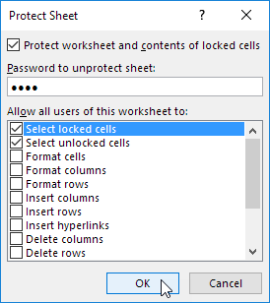
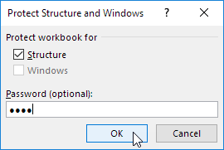
Protect (cont.)
Protect Workbook
Review → Changes → Protect Workbook → Enter Password
Protect Sheet
Review → Changes → Protect Sheet → Enter Password

Slide 14
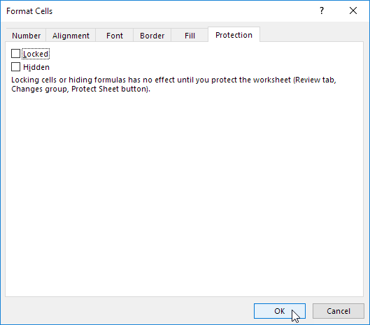
Protect – Lock Cells (cont.)
Lock Cells
Default – Locked
Select cells to unlock → Right click → Format Cells → Protection tab → Uncheck ‘Locked’

Slide 15
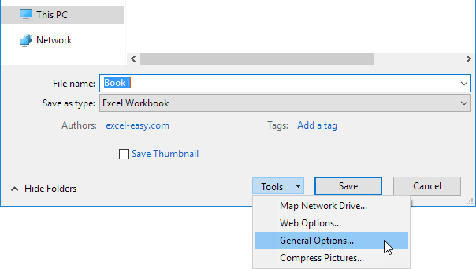
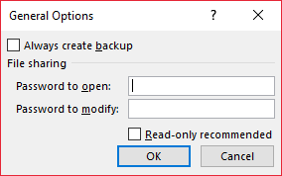
Protect – Read-only Workbook (cont.)
Read-only Workbook
Save As → Tools → General Options → Enter passwords

